Slide 1

DR S. & S.S GHANDHY GOVERMENT ENGINEERING COLLEGE , SURAT
PROJECT TITLE :- REAL TIME ENERGY MANAGEMENT SYSTEM USING PYTHON AND IOT
INTERNAL GUIDE :- J.R.RANA
NAME | ENROLLMENT NO.
VASAVALA ANKIT J. | 170230111063
PANCHAL PARTH J. | 170230111029
CHAUDHARI TEJASH Y. | 170230111005
VAGHELA HARDIK B. | 170230111062
BHATT DEV A. | 170230111002

Slide 2
CONTENTS OF THIS PRESENTATION
WHAT ARE WE MAKING?
WHAT ARE WE USING TO MAKE IT?
HOW IS IT GOING TO LOOK?

Slide 3
WHAT ARE WE MAKING?
Inefficient energy use has been a major issue globally.
So we are making project that can manage the use of power by appliance.
In our project we can collect the power consumption data from the appliance by using ACS712(Analog Current Sensor). It gives amount of current flowing through the appliance from which we are measuring power consumption.
We are using ESP8266 Soc by Espressif as brain of our project.
In ESP8266 Bluetooth and WiFi peripheral is embedded so we are getting it connected to a database server on the PAN in which power consumption data is stored of each electrical load.
By using tech stack of HTTP NodeJS SERVER we are making a dashboard on which all the real time data can be seen.
We can see this all data in form of various graph which was possible because of matplotlib.
It makes easy to understand the real time power consumption and this is visualized in the dashboard in a Power versus time graph.
Form the power consumption data we will be able to estimate the electricity bill of the user also the data set will be helpful for Data Scientist for research and analysis.

Slide 4
WHAT ARE WE USING TO MAKE IT?
Python
ESP8266 (Node MCU)
Internet of Things
Aruduino IDE
ACS712 (Analog Current Sensor)
AC to DC converter

Slide 5
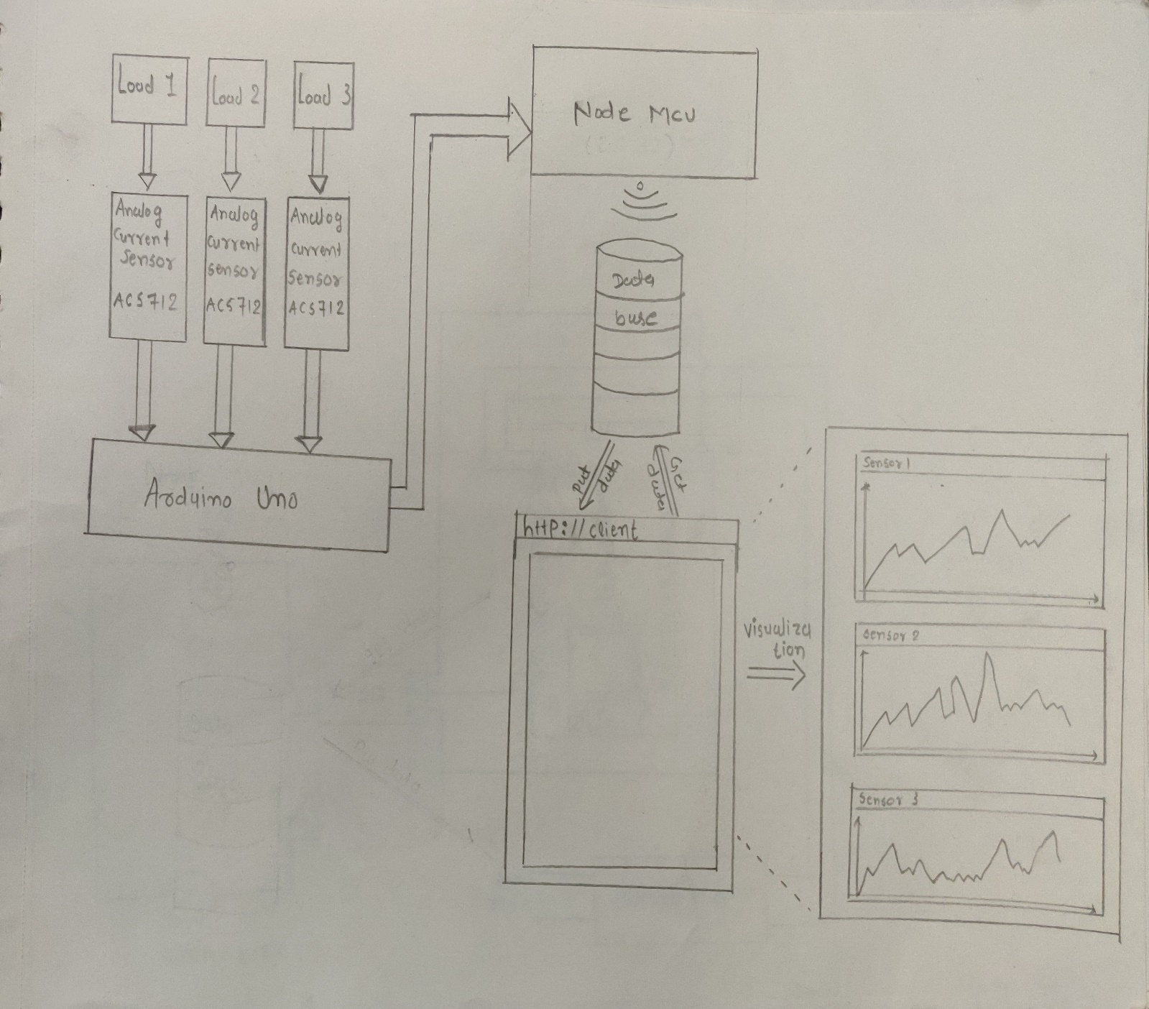
Block diagram

Slide 6
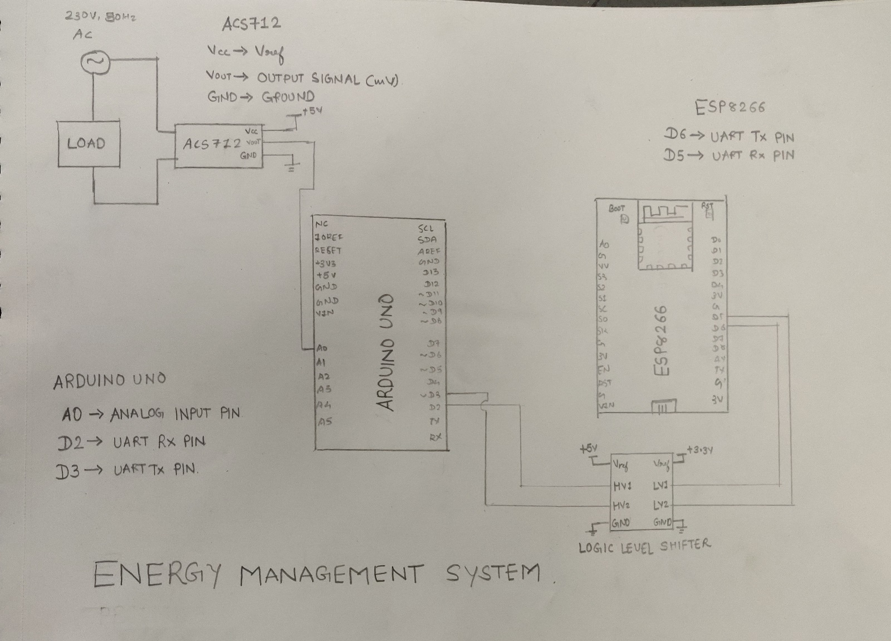
Circuit diagram CONTAINING ONE LOAD

Slide 7
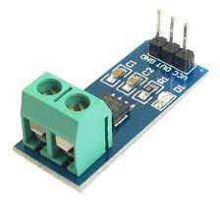


WORKING
We have connected the ACS712 current sensor in series with the line and load.
by which we are getting the current flowing through the load.
on the basis of the current we are calculating the energy consumed by the load in unit time.

Slide 8
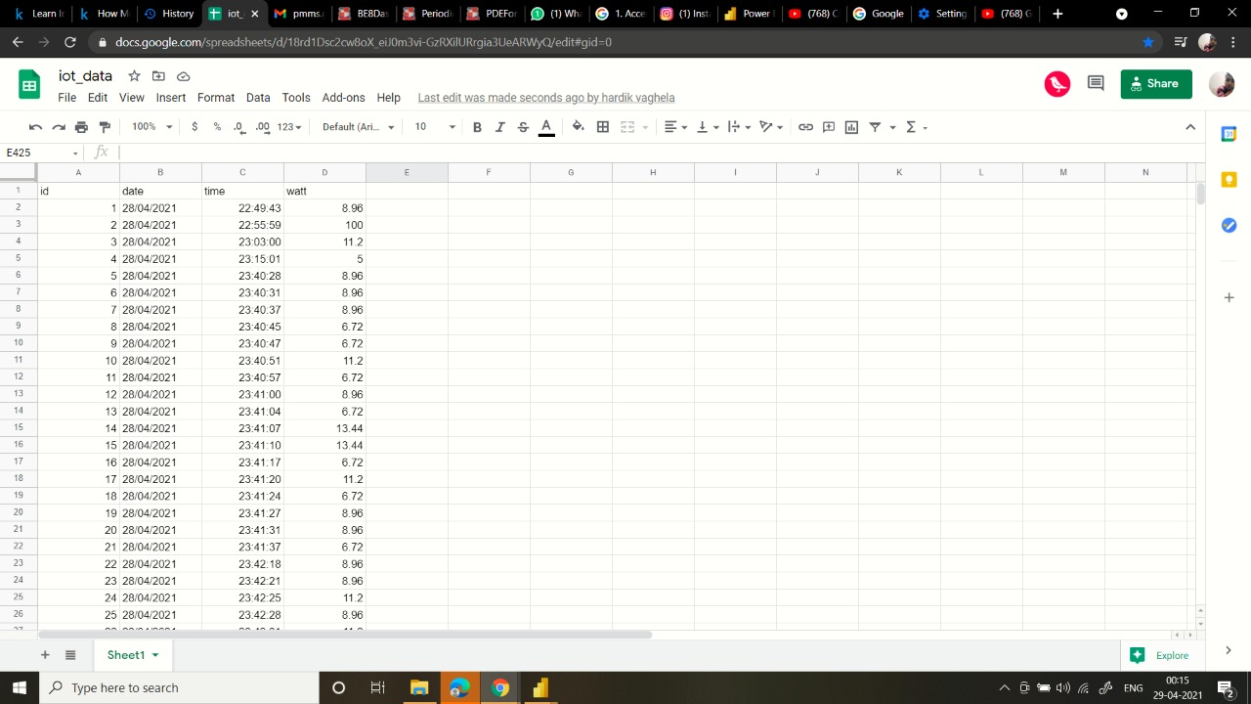
and uploading the watt data to our data set in google sheets via http protocol.

Slide 9
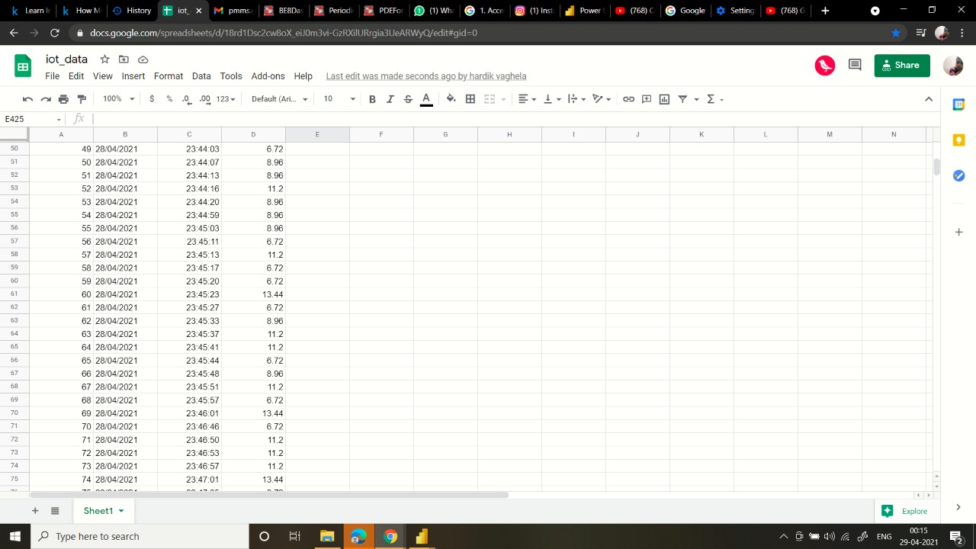

Slide 10
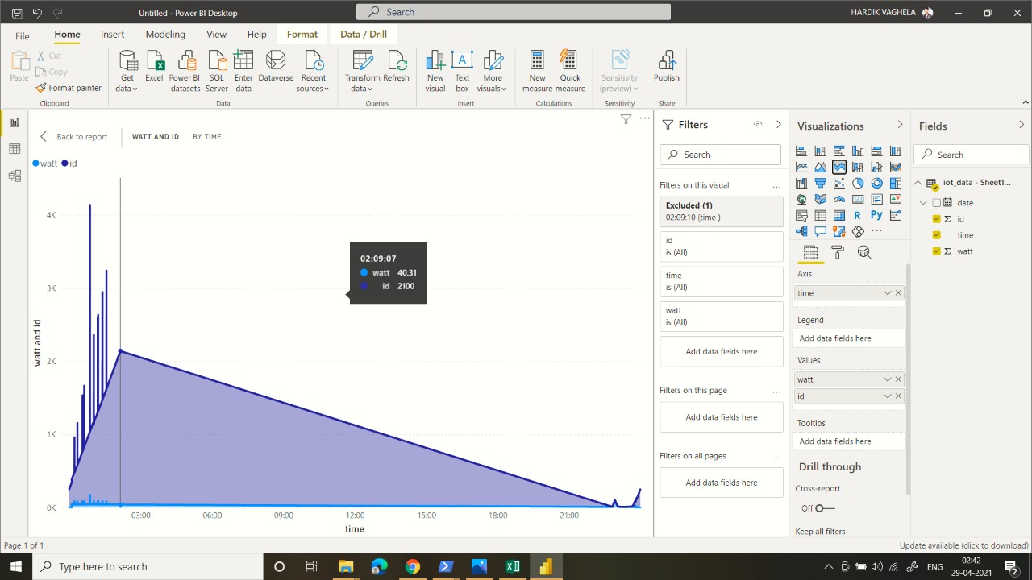
Power data is getting stored every 3 second in the dataset.
After that this collected data converted into graphical to understand the consumption of energy of appliance.
This collected data we show in form of the different types of chart.

Slide 11
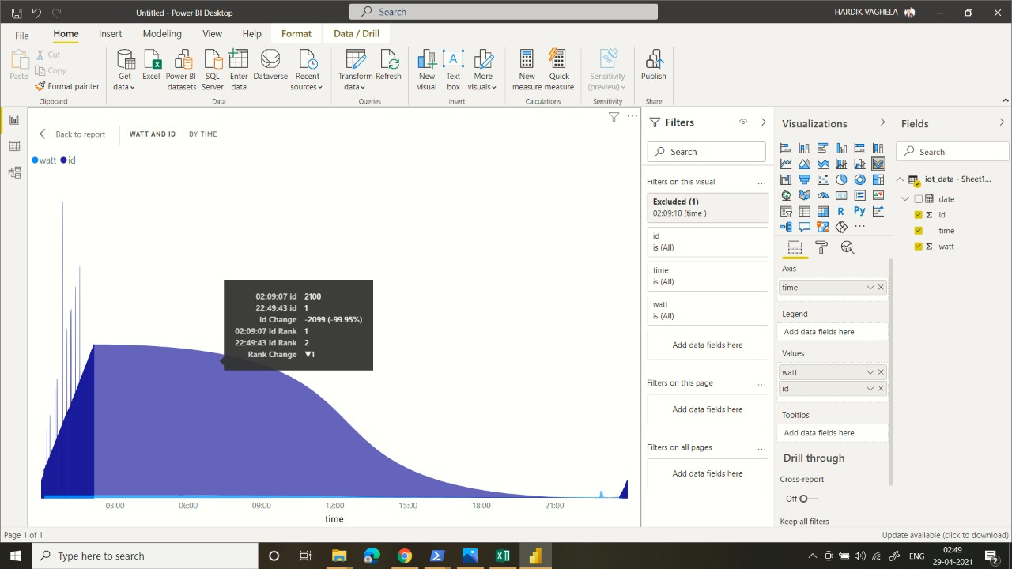
This chart shows as power consumption of appliance of every 3 second by this we can see the power consumption of appliance in form of chart.
We can see the consumption of the power of last month.
And then we can predict the electricity bill of next month by observing the data chart of the power consumption of appliance.

Slide 12
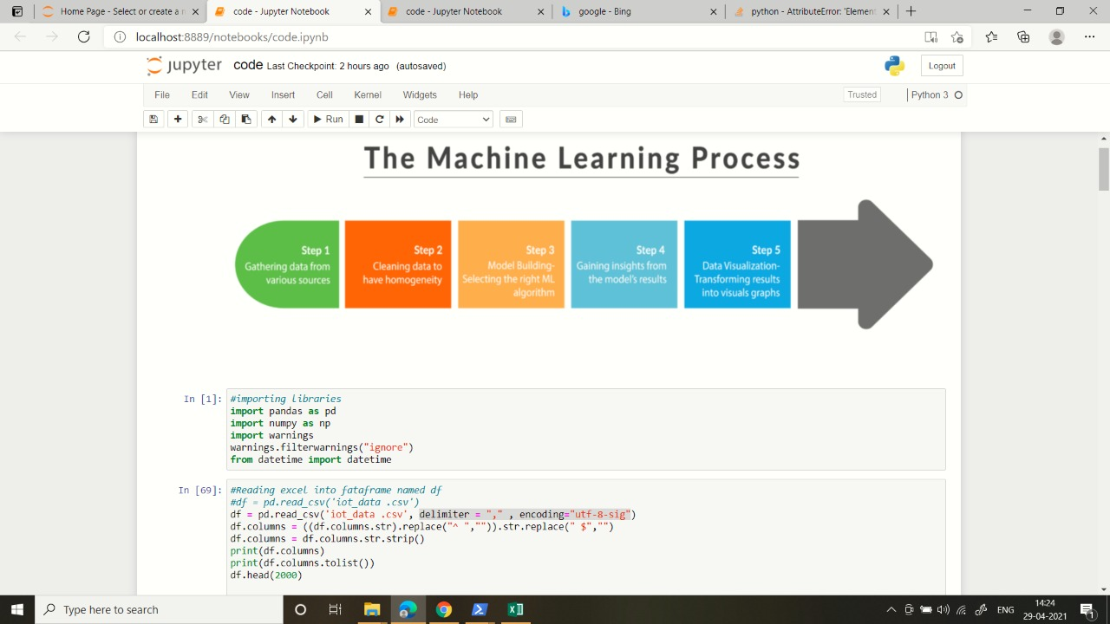
Machine learning

Slide 13
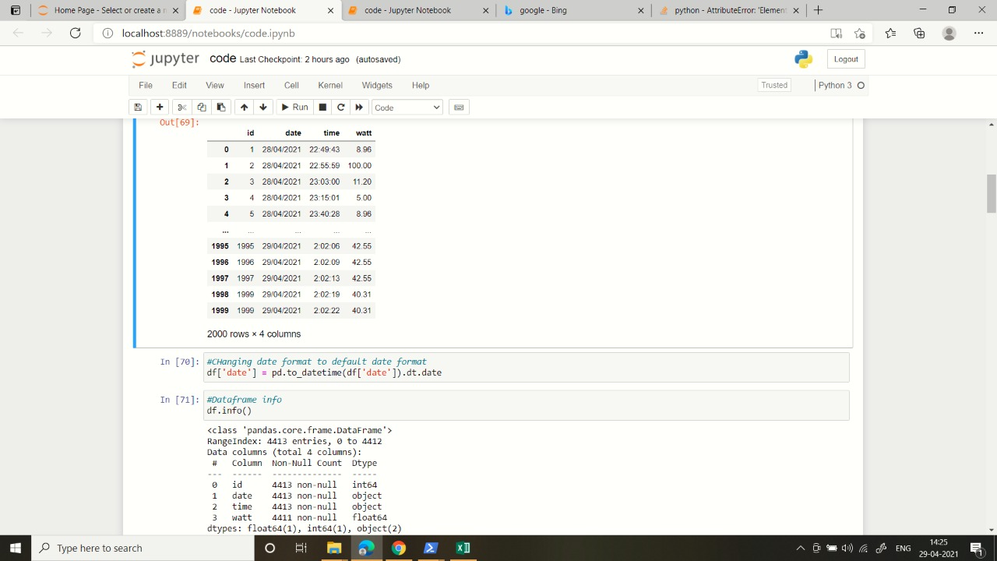
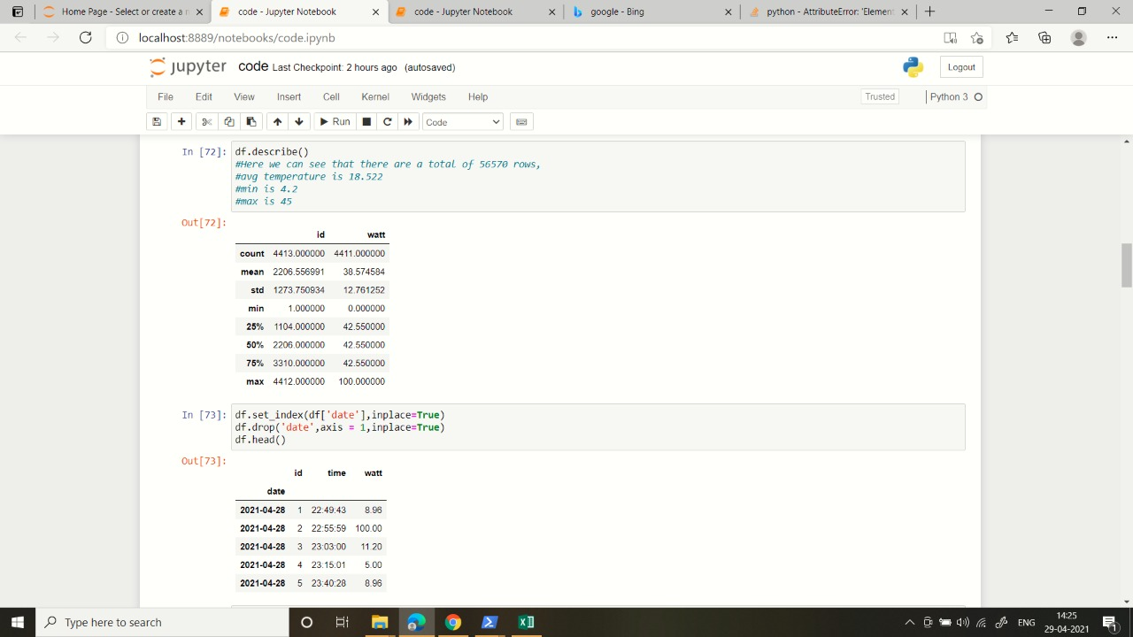

Slide 14
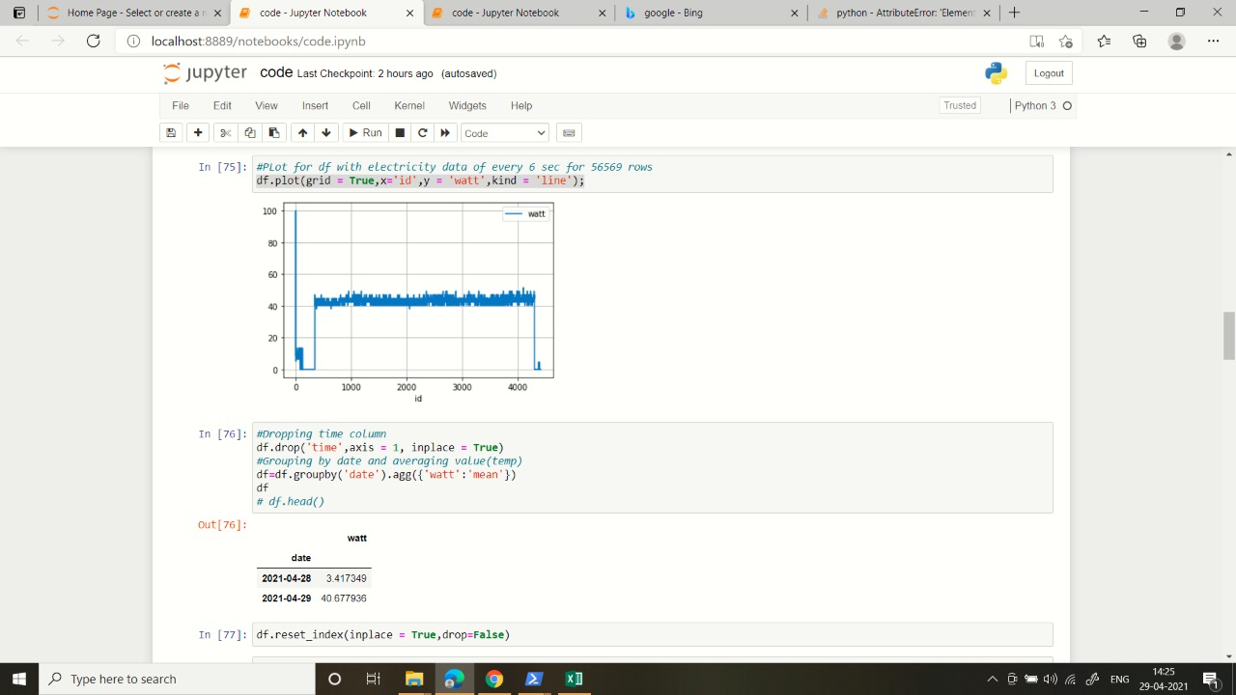
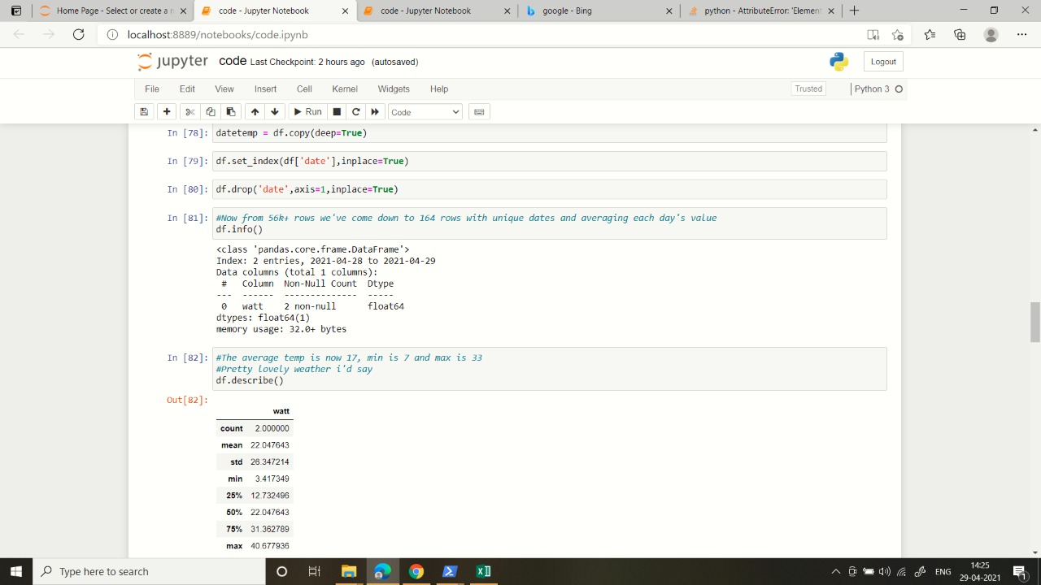

Slide 15
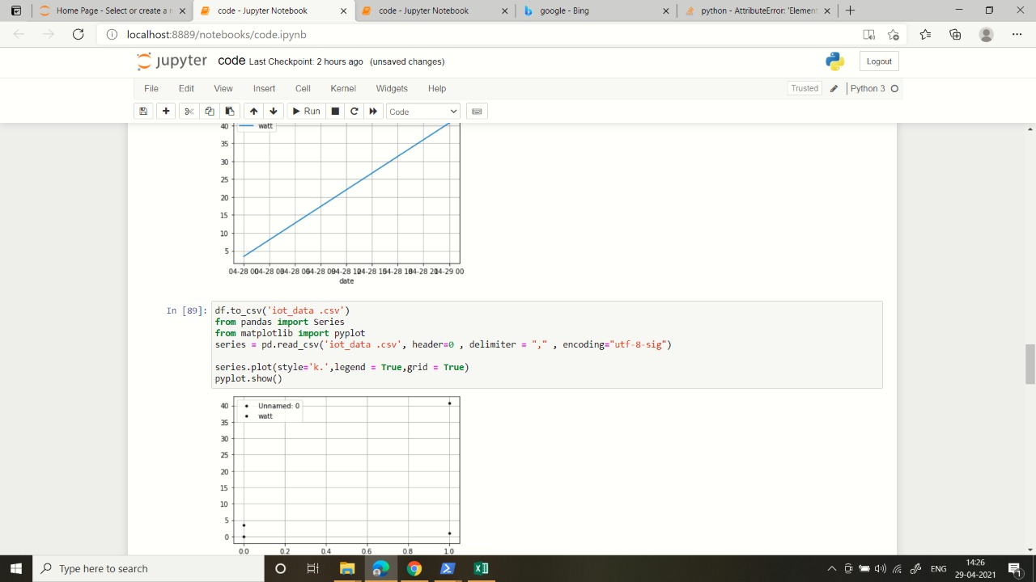
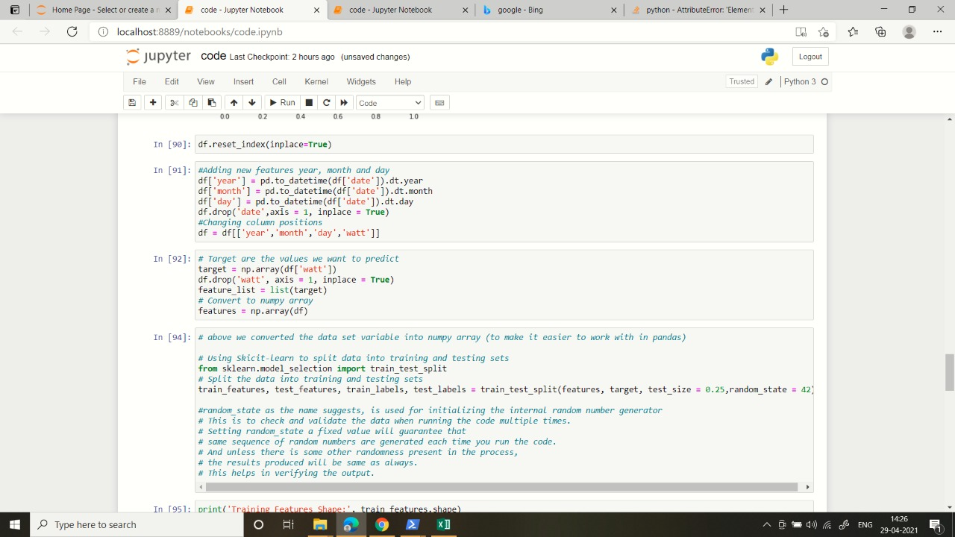

Slide 16
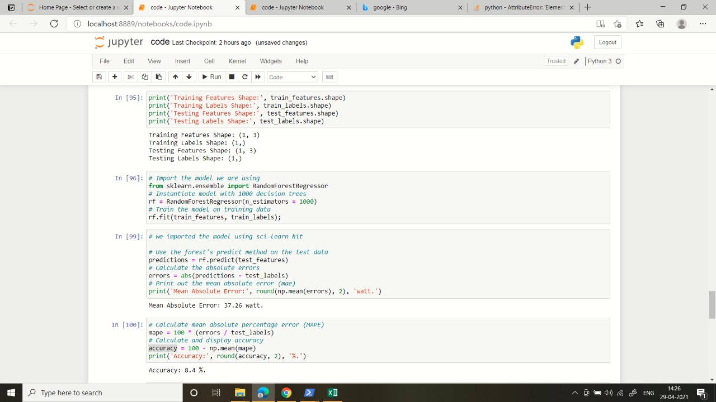

Slide 17
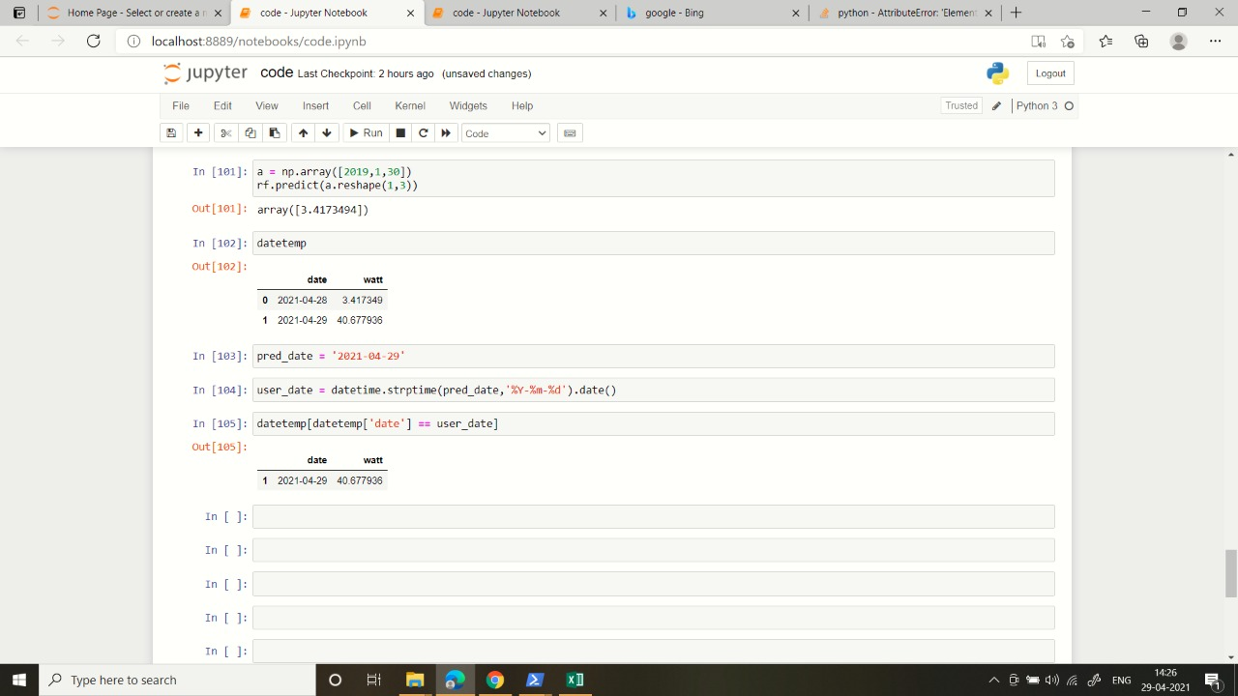

Slide 18
Aim and objectives of the project
To make use of electric energy efficient.
Collect data which could be helpful for data scientist for research and analysis purpose.
Individual could know the power consumption by the electric appliances.

Slide 19
Conclusion
Electric energy is going to take over all other energy sources in the near future our aim is to monitor its usage and collect data for research and development and make the use of this energy as efficient as possible.
Our project does all these things and the power consumption by the monitoring devices is very low
We are also going to add some intelligence keeping some appliances under observation and collecting data through which we can make electrical appliances to go in the low power mode at appropriate situation.

